Slide 1


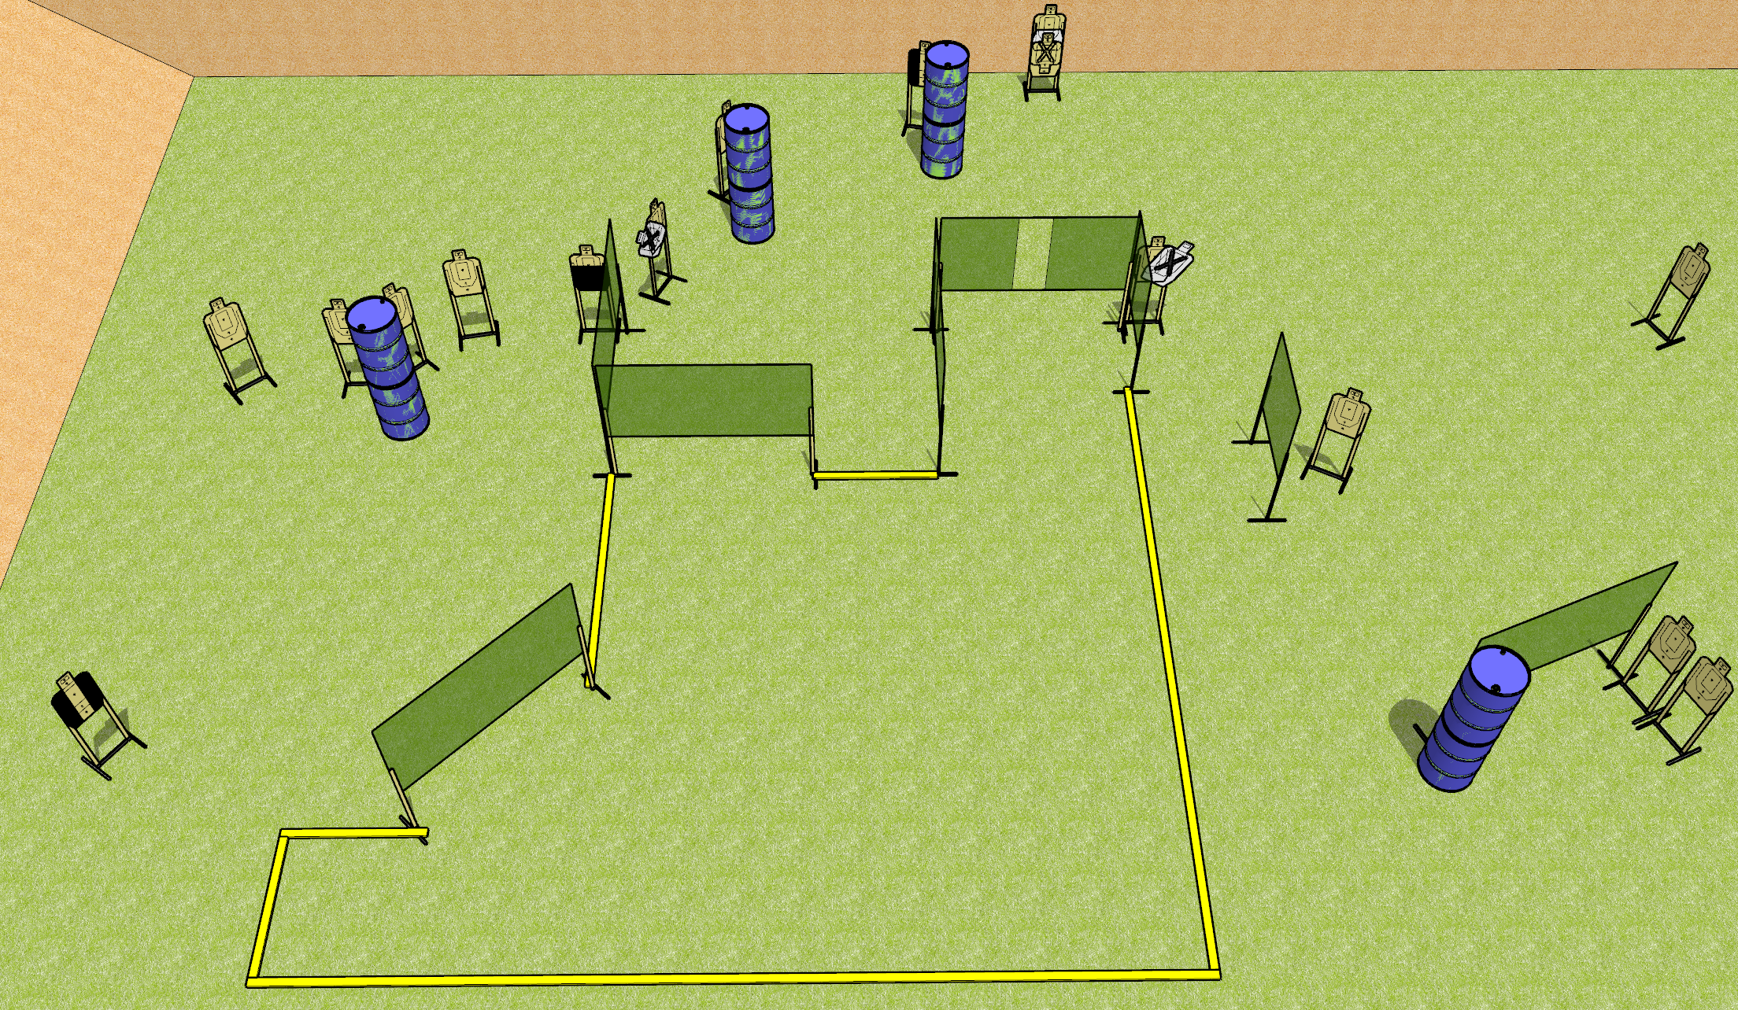
 | Dothan Gun Club – USPSA Match Hating on Jamie Course Designer : Drew Coleman
Round Count 32 rounds 16 USPSA
Equipment List 13 wall feet 3 medium fault lines 2 tuxedos, 1 50%

Slide 2
Hating on Jamie
Written Stage Briefing
Hating on Jamie is a 32 round, 160 point, Comstock course of fire. There are 16 USPSA targets. The best 2 hits on paper will score, and steel must fall to score. The start signal is audible.
Handgun start position is anywhere inside the shooting area. Handgun is loaded and holstered.
PCC start position is muzzle anywhere inside the shooting area, stock on belt. Carbine is loaded with safety on.
On start signal, engage targets as they become available from within the shooting area.

